Slide 1
Motional Control of Loudspeakers
Sujit Malde
3rd Year Project Symposium

Slide 2
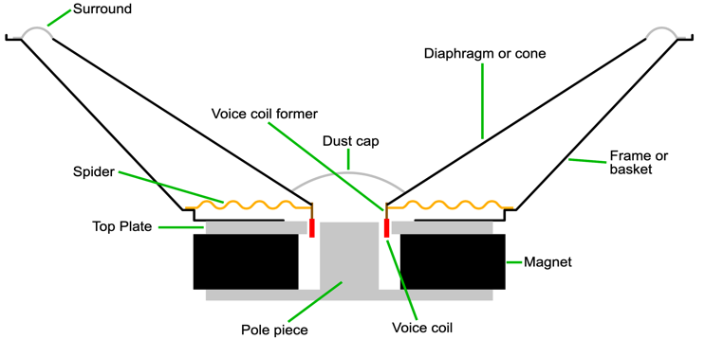

Slide 3
https://github.com/spez1998/3rd-year-project

Slide 4
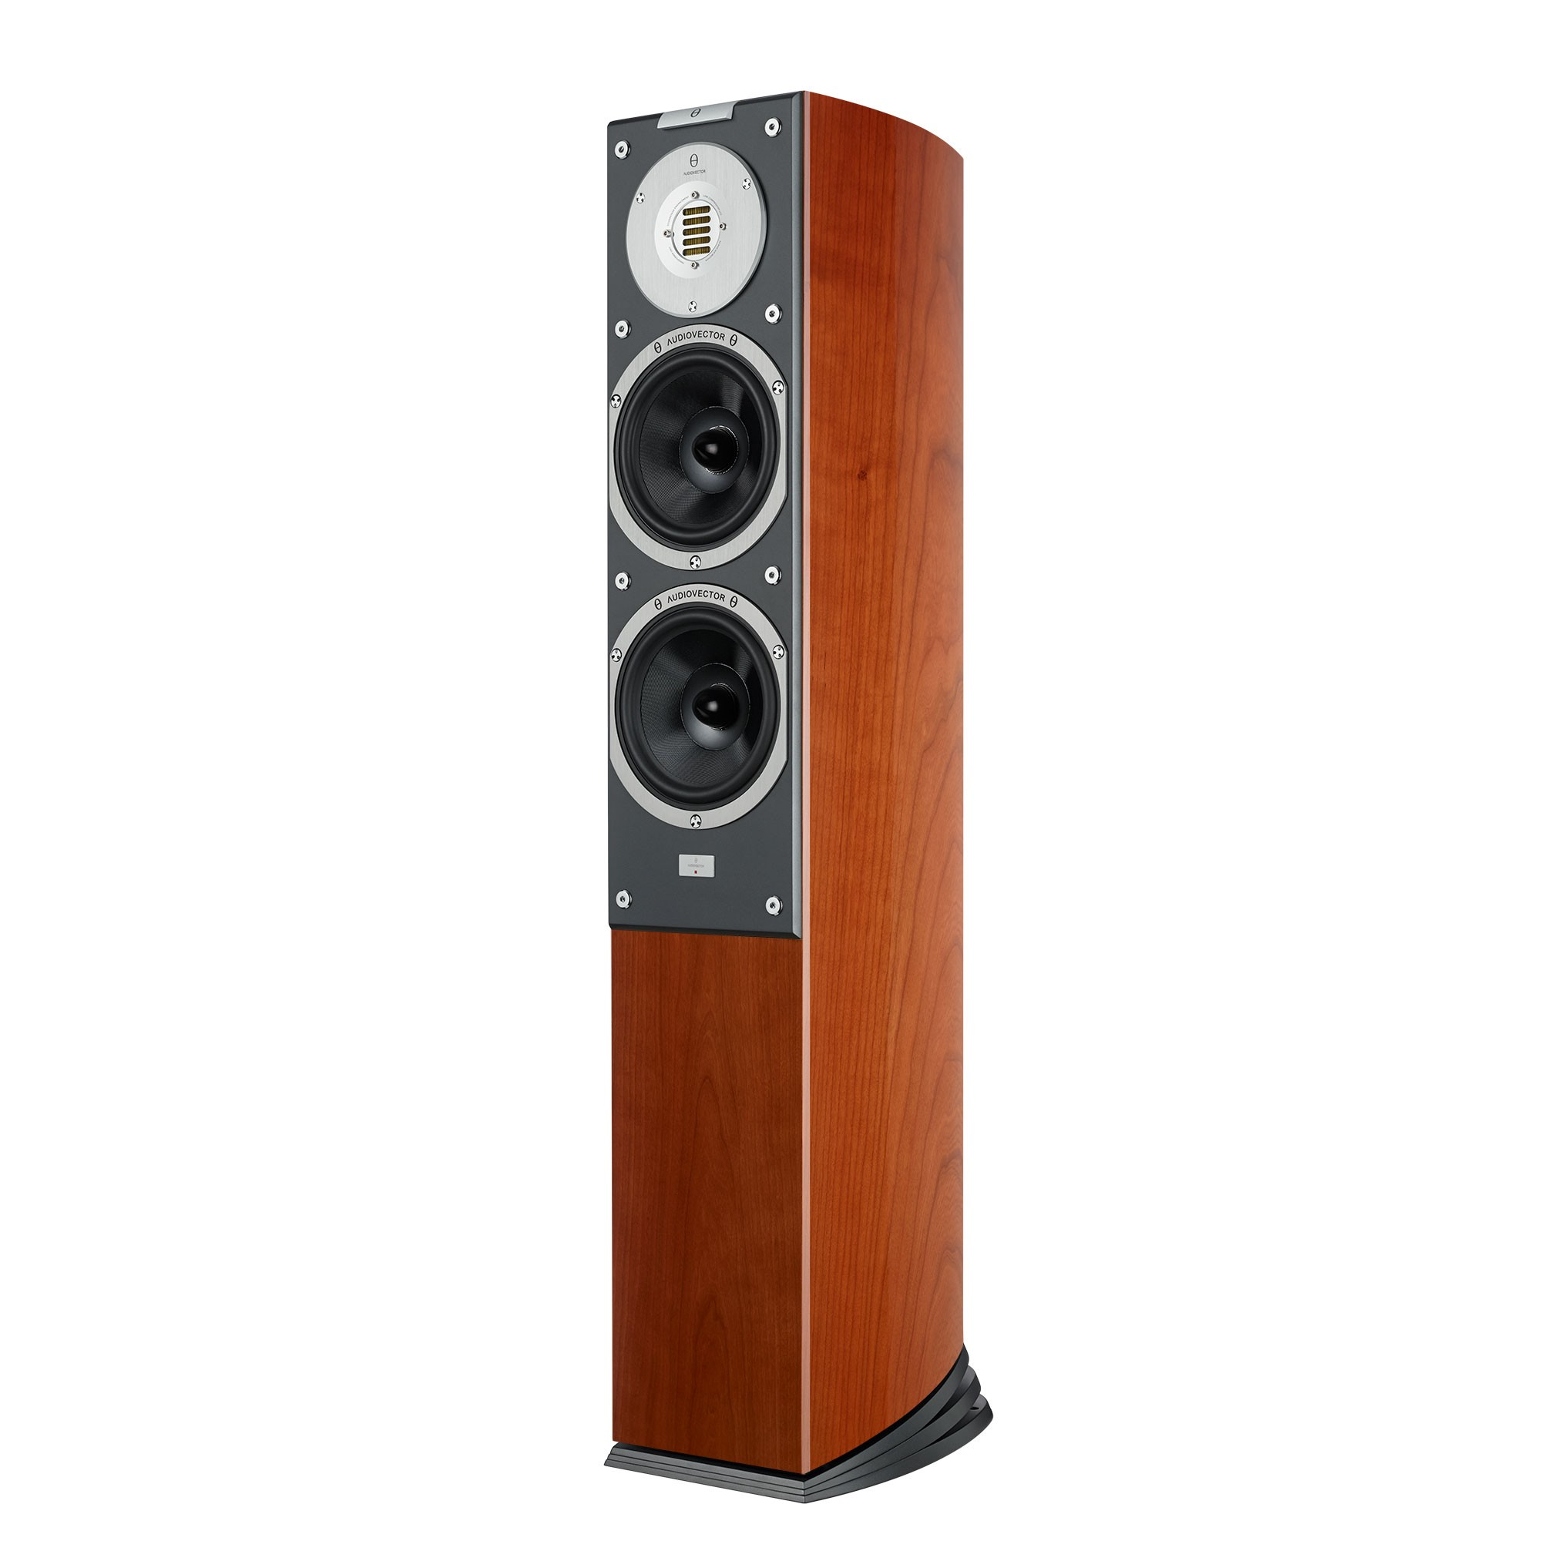
Background
Loudspeakers should be:
Small
Efficient
Linear
Linearity is hard to achieve
Most consumers don’t have access to good sound quality
Subwoofers perform the worst as proven by mathematics
https://audiovector.com/sr-3-avantgarde-arrete.html

Slide 5
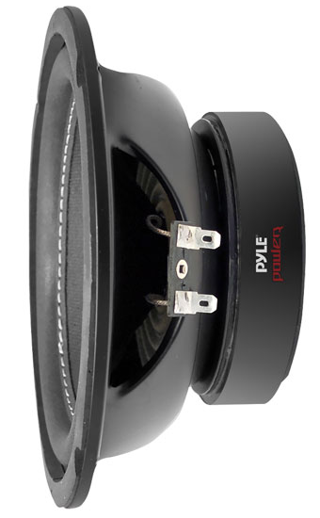
Background
Electronic controllers are the solution.
Open-loop controllers e.g. EQ filters are well-known and used by enthusiasts
Closed-loop controllers only used experimentally
Compare between each type to determine which is best
https://www.thompsonsltd.co.uk/touring-and-leisure/plpw6d-pyle-plpw6d-6.5-600-watt-dual-voice-coil-4-ohm-subwoofer.html

Slide 6
Aims
Design & build an enclosure – one that helps to improve the quality of sound if possible
Compare controlled subwoofer setups against non-controlled setups and determine which controller is the best.
Keep the costs down.

Slide 7
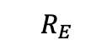


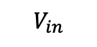


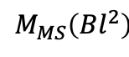

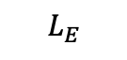
Theory
Mass of cone and air
Mechanical resistances
Compliance of cone suspension / of box
$$R_{E}$$
$$L_{E}$$
$$I$$
$$V_{in}$$
$$M_{MS}\left(Bl^{2}\right)$$
$$\frac{C_{MS}}{{\left(Bl\right)}^{2}}$$
$$\frac{{\left(Bl\right)}^{2}}{R_{MS}}$$
$$\frac{C_{B}}{{\left(Bl\right)}^{2}}$$
$$\frac{{\left(Bl\right)}^{2}}{R_{B}}$$
Voice coil circuit
Driver mechanical equivalent circuit
Box mechanical equivalent circuit
Mechanical circuit is a referred transformer secondary with turns ratio Bl
Useful for SPICE/MATLAB
Not easy information for end-users to digest
Some can’t be measured, manufacturers don’t give any of these values on datasheets
Thiele/Small parameters used instead

Slide 8
Theory cont.
VAS Volume of air that, when compressed to 1 cm³, exerts the same force on the cone as the cone suspension | Z_{nom} Voice coil nominal impedance | D Cone diameter
Q_{M} Mechanical circuit Q-factor | Q_{E} Electrical circuit Q-factor | Q_{T} Total circuit Q-factor
f_{S} Driver resonant frequency | Bl Force-current constant | X_{MAX} Maximum cone excursion

Slide 9
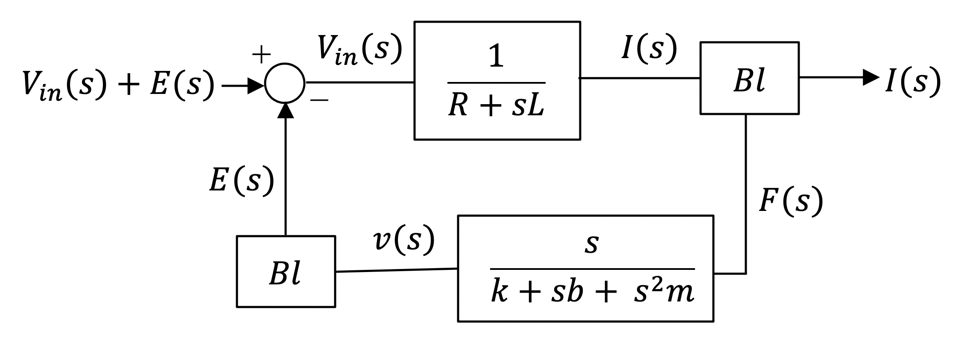
Theory cont.
Closed-loop is more desirable than open-loop
Open- and closed-loop controllers are inflexible but…
Closed-loop control theory allows for:
State observers (obtain values for normally unmeasurable equivalent circuit parameters)
Disturbance observers (measure disturbances that affect system performance such that they can be eliminated)
Estimators (predict how certain loudspeaker parameters change over time)

Slide 10
Methodology
Choose a subwoofer. Ideally cheap and small to prove that it’s the technology that makes the system sound good, not the build quality of the system alone. Pyle PLPW6D → cheap, small, dual voice-coils = more freedom down the road

Slide 11
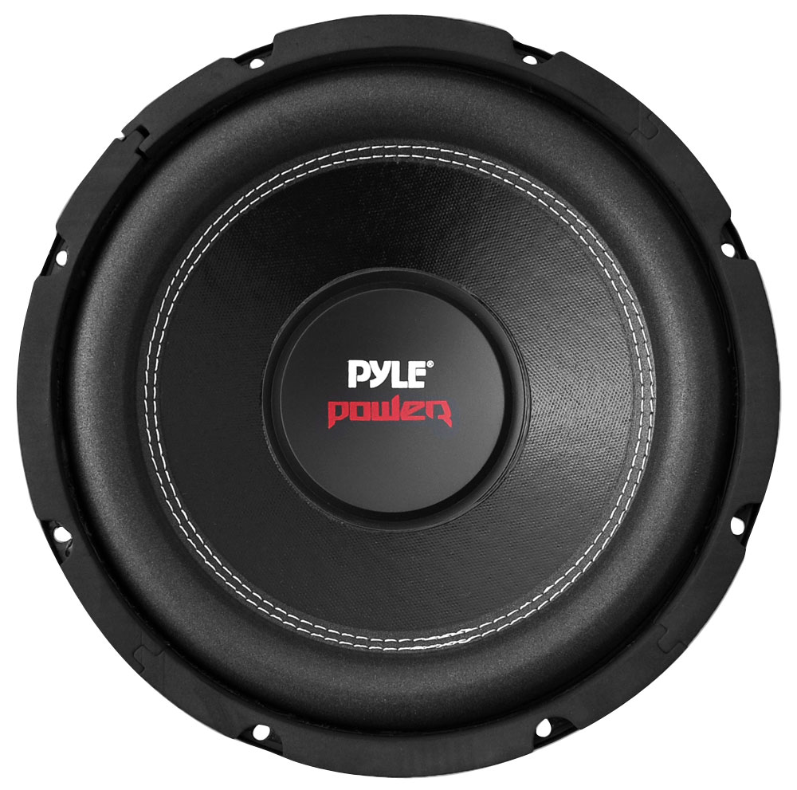
Methodology
Pyle PLPW6D:
Cheap (RRP $40)
Small (6-inch diameter)
Dual voice coils (more freedom of design)
https://www.thompsonsltd.co.uk/touring-and-leisure/plpw6d-pyle-plpw6d-6.5-600-watt-dual-voice-coil-4-ohm-subwoofer.html

Slide 12
Methodology
Choose a subwoofer. Ideally cheap and small to prove that it’s the technology that makes the system sound good, not the build quality of the system alone. Pyle PLPW6D → cheap, small, dual voice-coils = more freedom down the road
Impedance measurements for unmounted subwoofer.

Slide 13
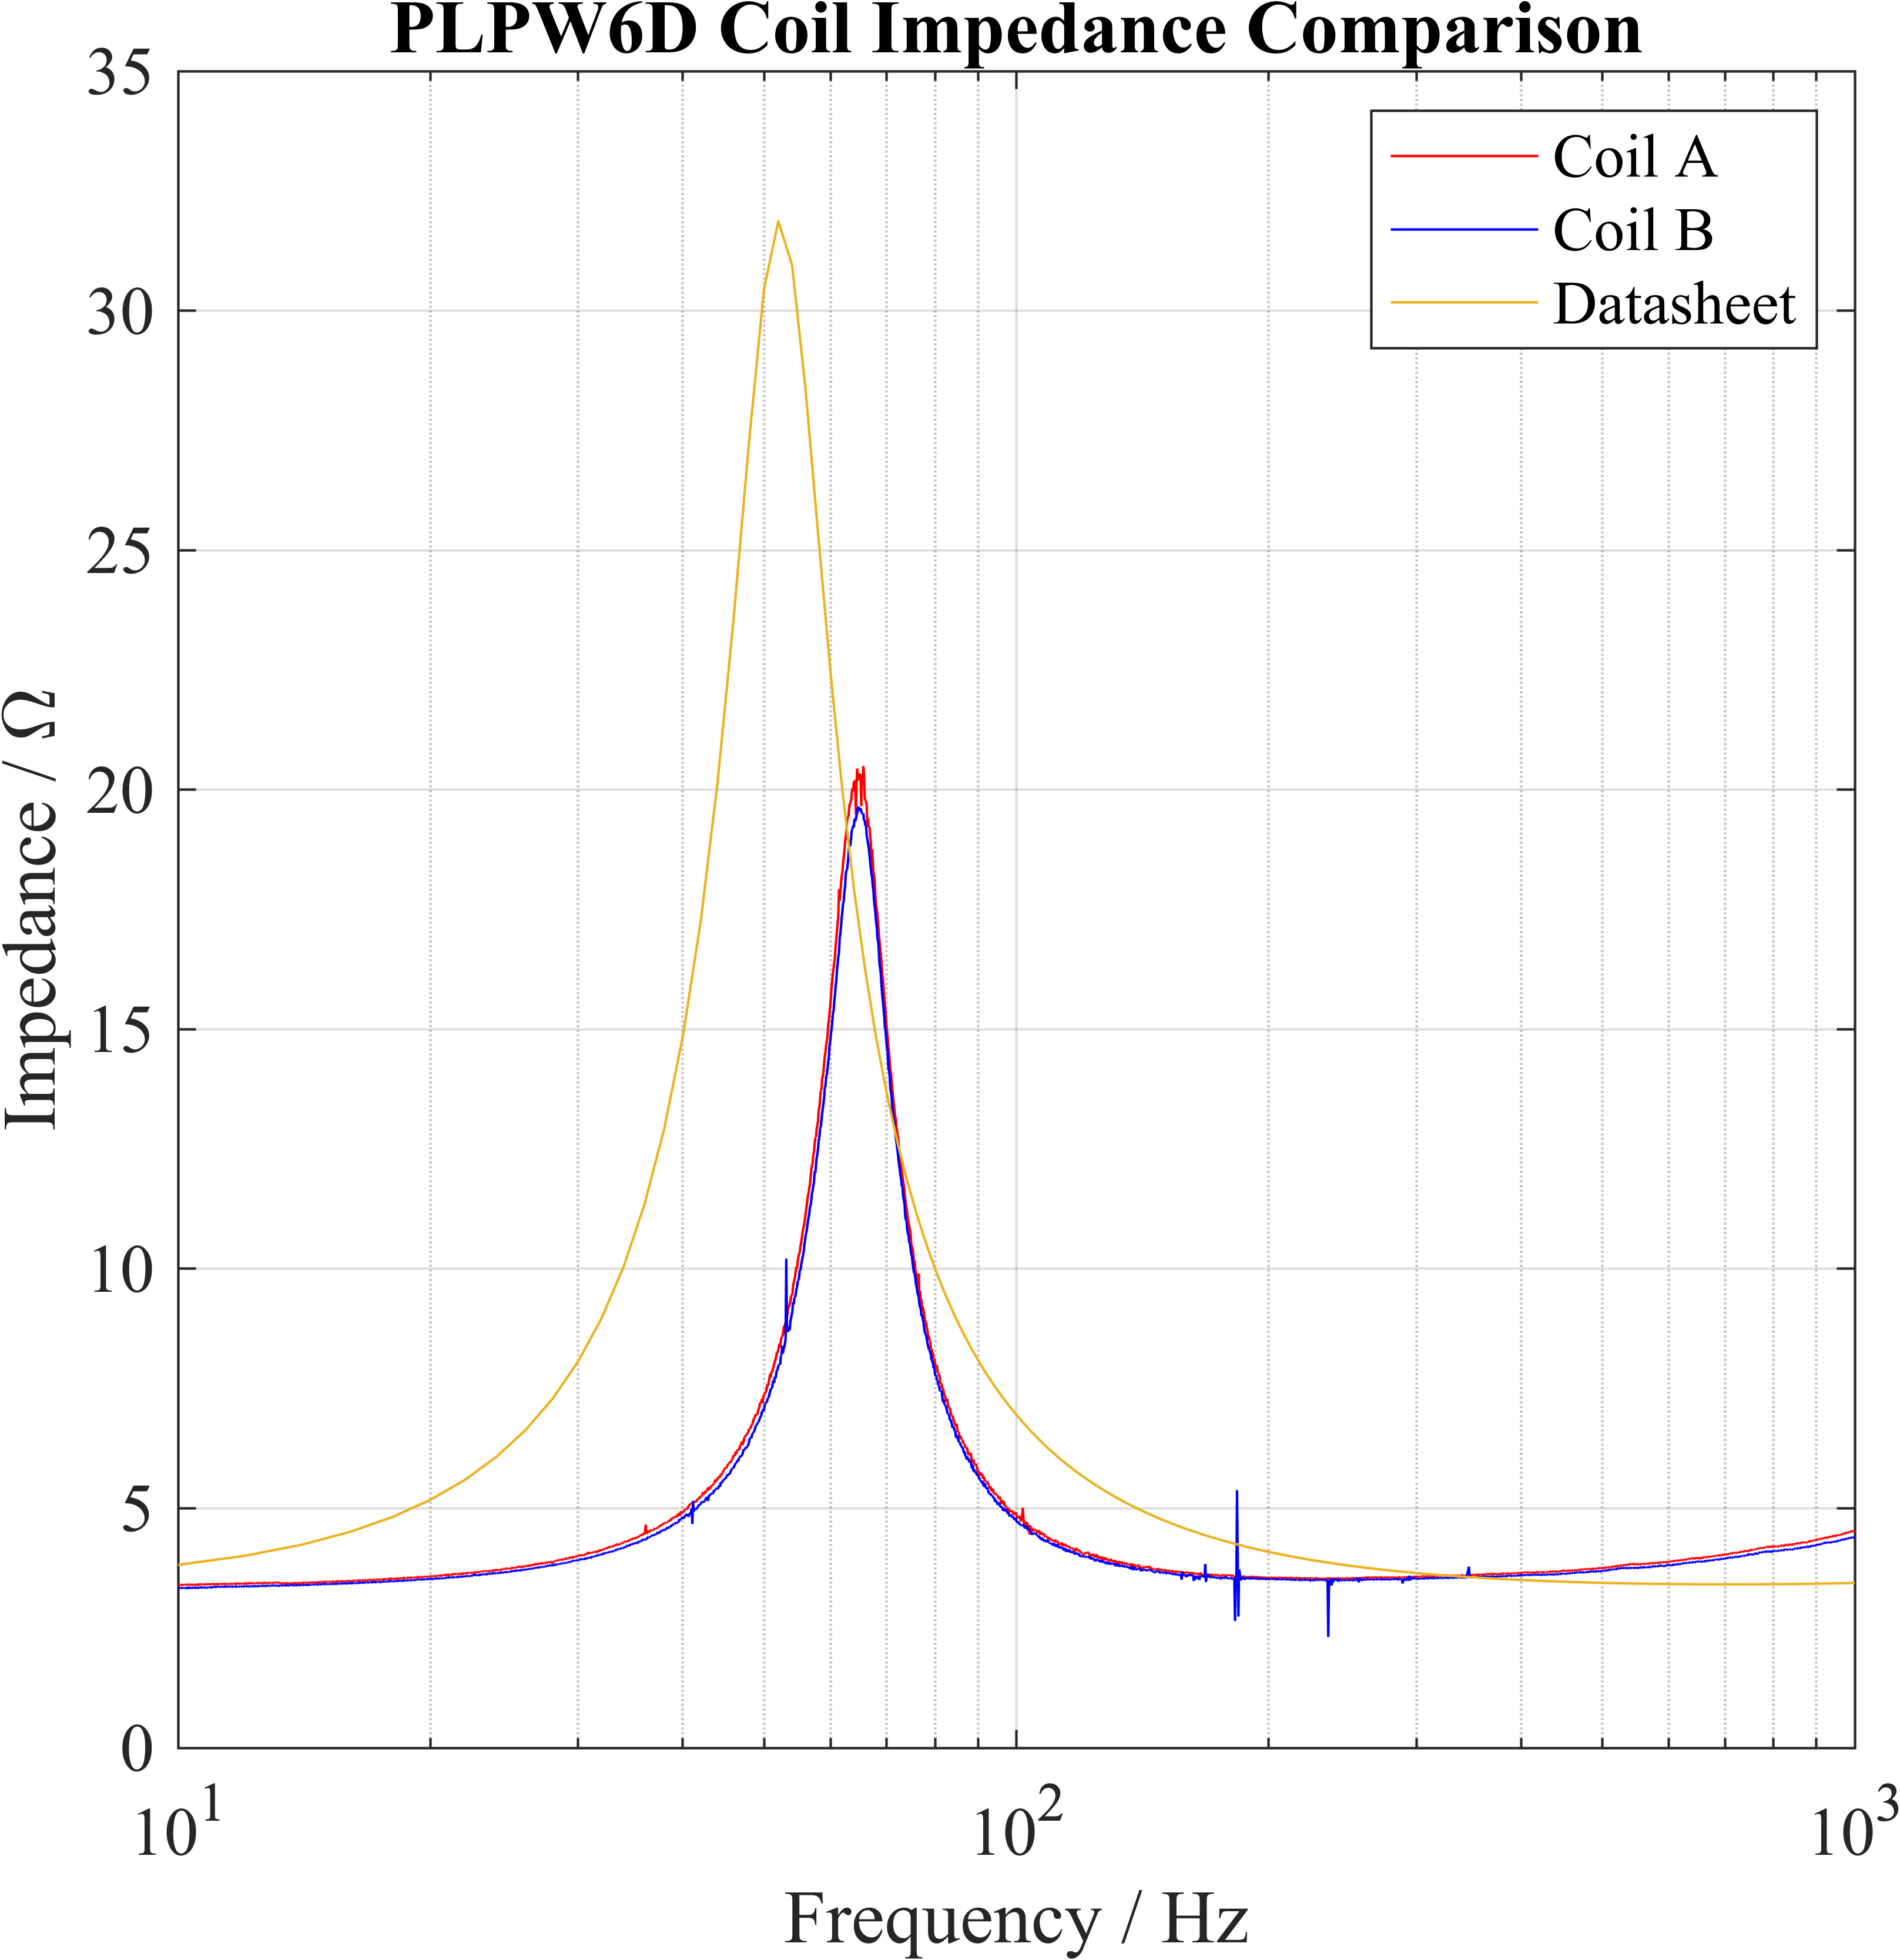
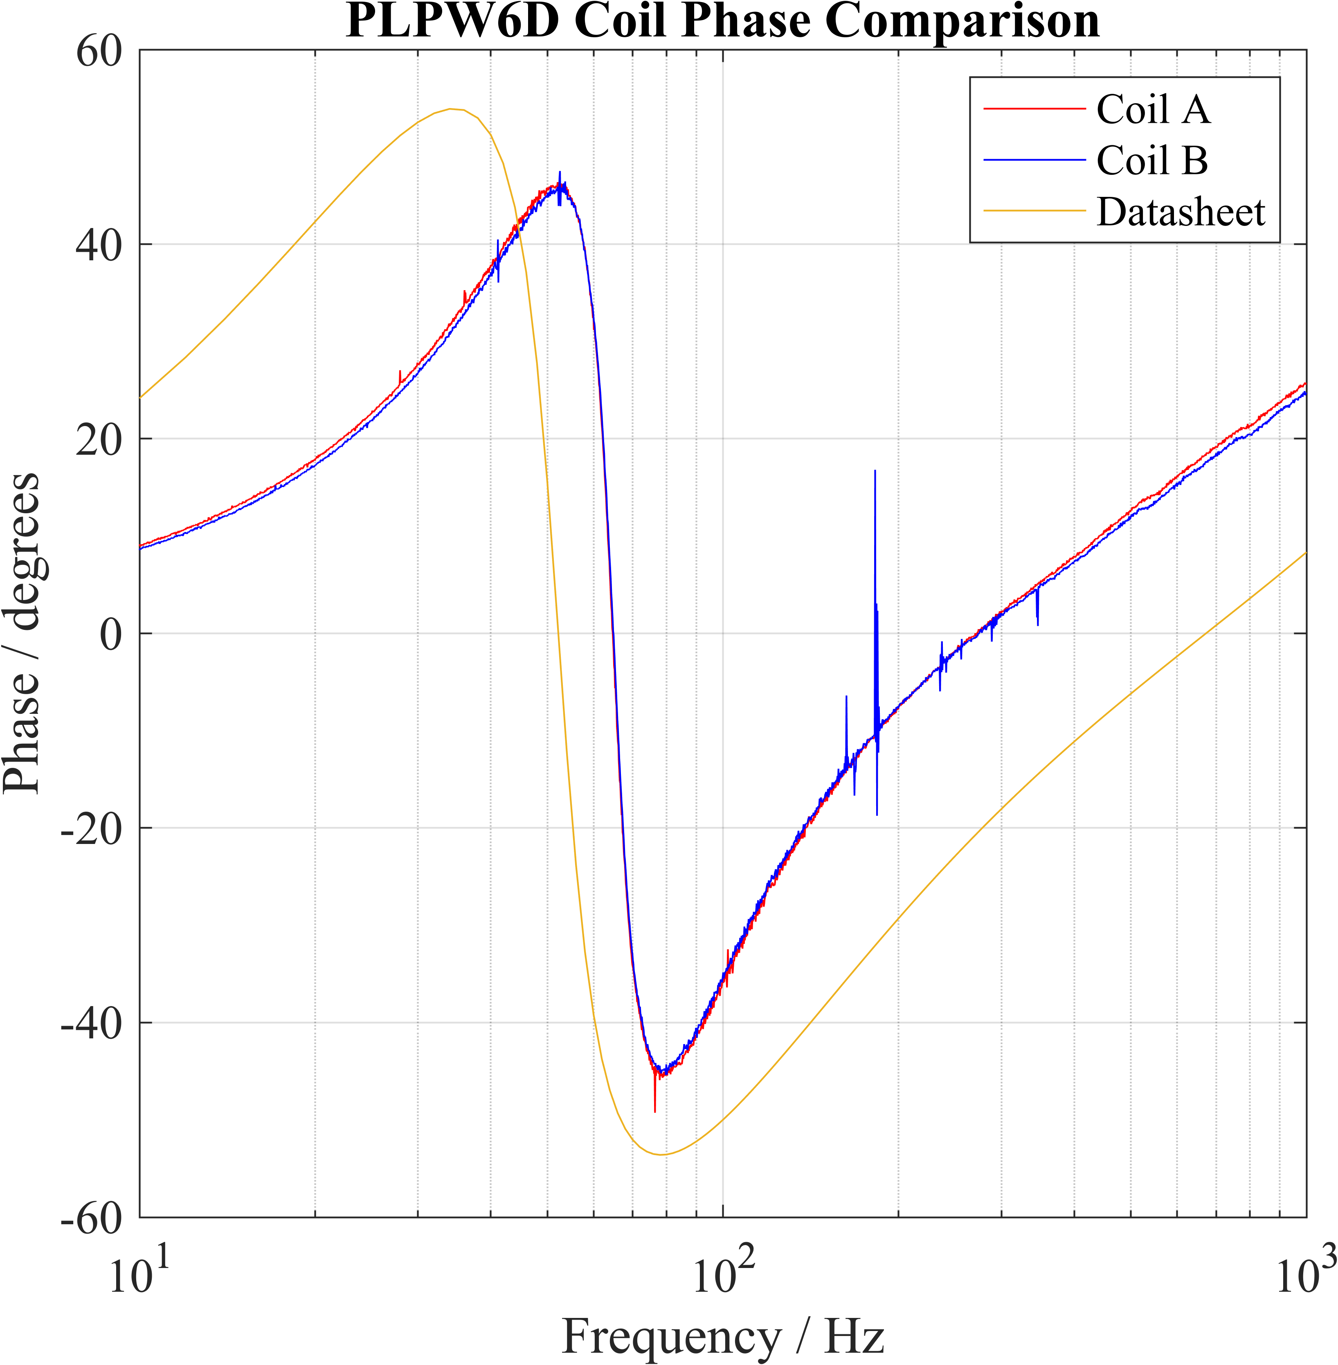
Methodology

Slide 14
Methodology
Choose a subwoofer. Ideally cheap and small to prove that it’s the technology that makes the system sound good, not the build quality of the system alone. Pyle PLPW6D → cheap, small, dual voice-coils = more freedom down the road
Impedance measurements for unmounted subwoofer.
Enclosure design: balance between f_{S}, power requirements, box size
Lower f_{S} = bigger box, more power to push larger volumes of air
Smaller box = higher f_{S}

Slide 15
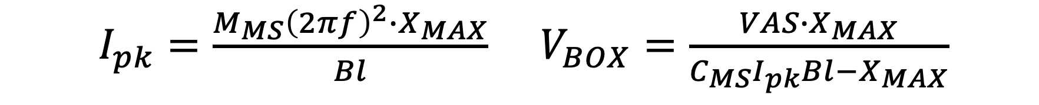
Methodology
$I_{pk}=\frac{M_{MS}{\left(2πf\right)}^{2}∙X_{MAX}}{Bl}$ $V_{BOX}=\frac{VAS{∙X}_{MAX}}{C_{MS}I_{pk}Bl−X_{MAX}}$

Slide 16
Methodology
Choose a subwoofer. Ideally cheap and small to prove that it’s the technology that makes the system sound good, not the build quality of the system alone. Pyle PLPW6D → cheap, small, dual voice-coils = more freedom down the road
Impedance measurements for unmounted subwoofer.
Enclosure design: balance between f_{S}, power requirements, box size
Lower f_{S} = bigger box, more power to push larger volumes of air
Smaller box = higher f_{S}
Enclosure construction.

Slide 17
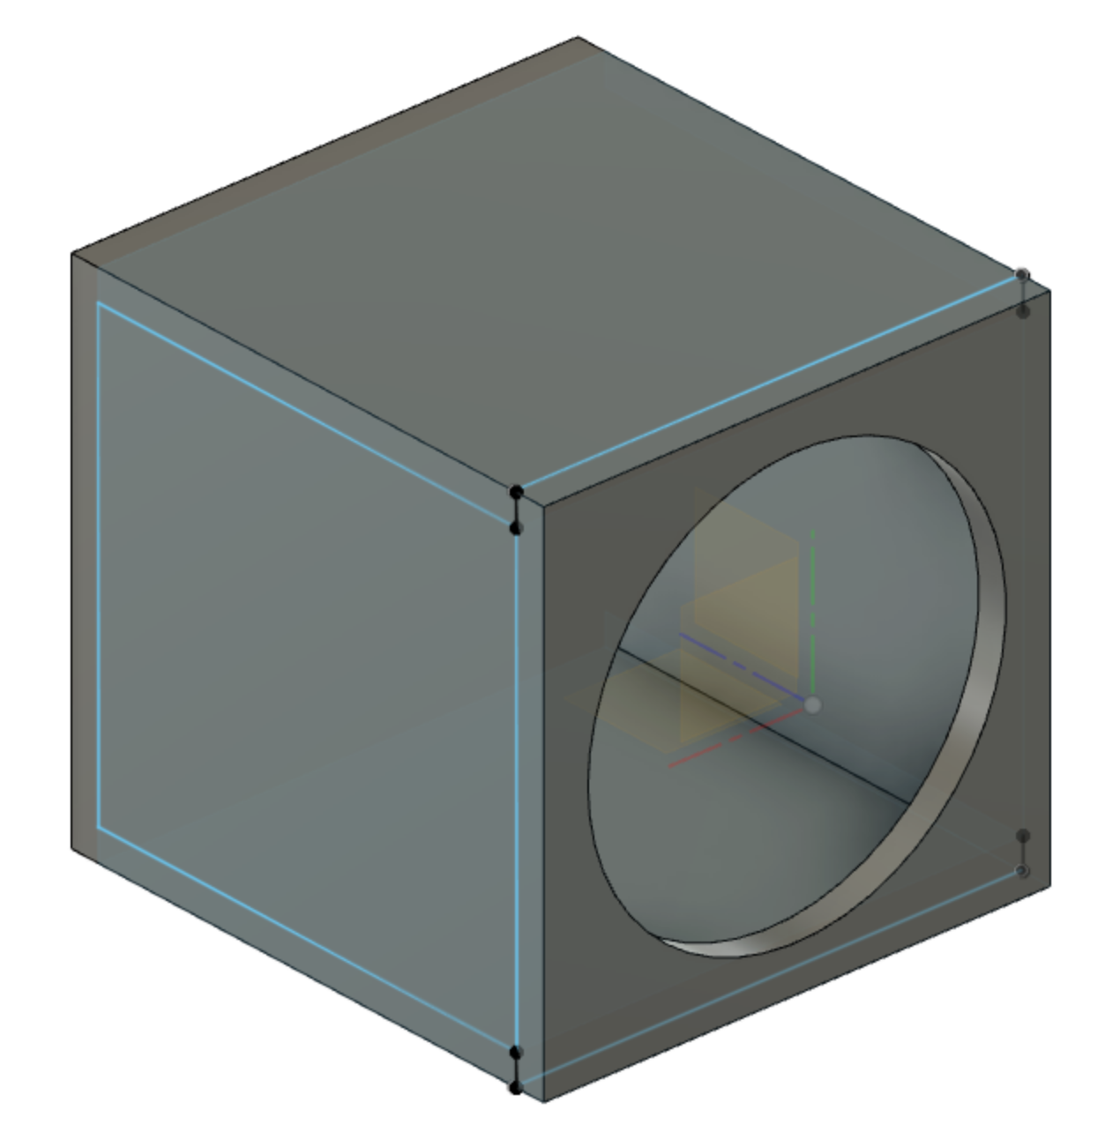

Slide 18
Methodology
Impedance measurements pt. 2.
Choose open-loop compensator.

Slide 19
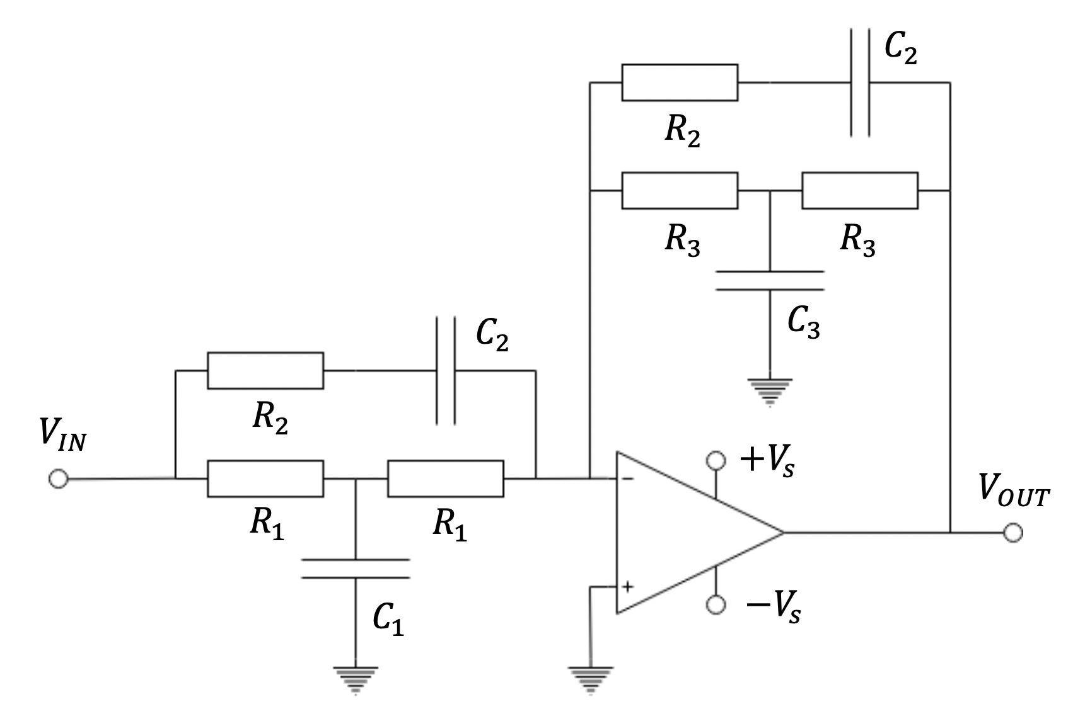
+V_{S} = 15 V, –V_{S} = –15 V
C₁ = 197 nF, C₂ = 69 nF, C₃ = 62 nF
R₁ = 15.4 kΩ, R₂ = 13.3 kΩ, R₃ = 442 kΩ

Slide 20
Methodology
Impedance measurements pt. 2.
Choose open-loop compensator.
Choose closed-loop controllers.

Slide 21
Method cont.
Impedance measurements pt. 2.
Choose open-loop compensator.
Choose closed-loop controllers.
Tune controllers using 2nd round impedance measurements. Collect data and compare with uncontrolled equivalent.

Slide 22
Method cont.
Due to COVID-19, many simulations were conducted in lieu of actual controllers being built and tuned. As such, the results must be considered as guidelines for the presented methodology, to be used as validation in the case where this project is undertaken in real life. 3 Simulink models were designed to collect data about each system setup.

Slide 23
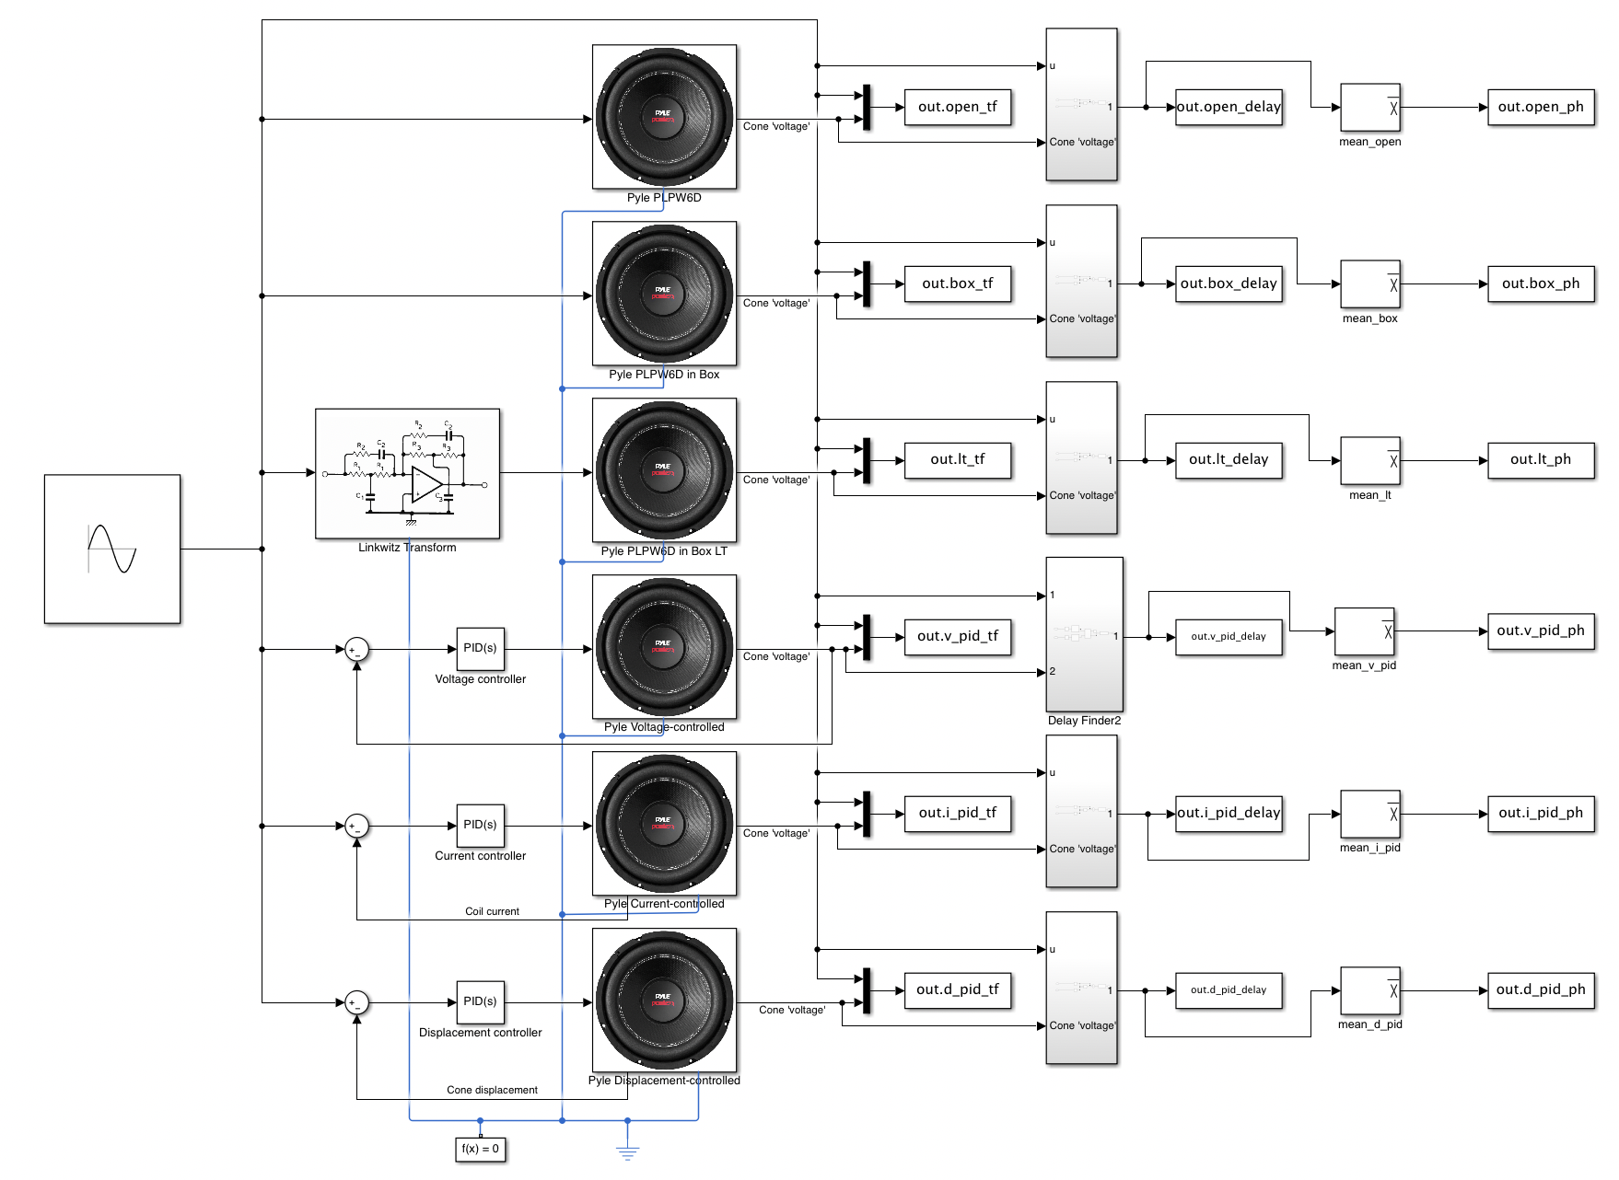
This model interfaces with a script which automatically runs simulations at desired frequencies and determines the magnitude response, phase response, and group delay.

Slide 24
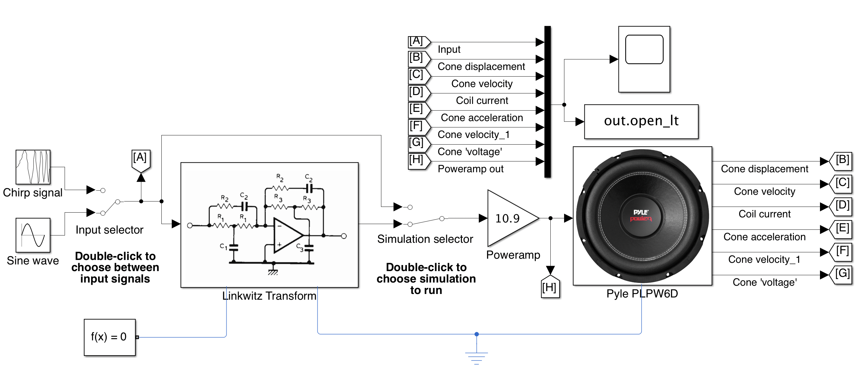
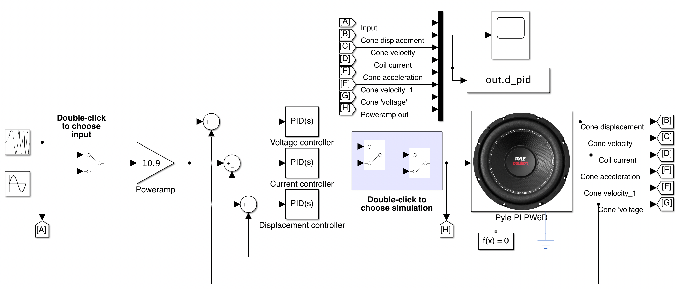
These models are more user-friendly and examine the loudspeaker at a much more granular level.

Slide 25
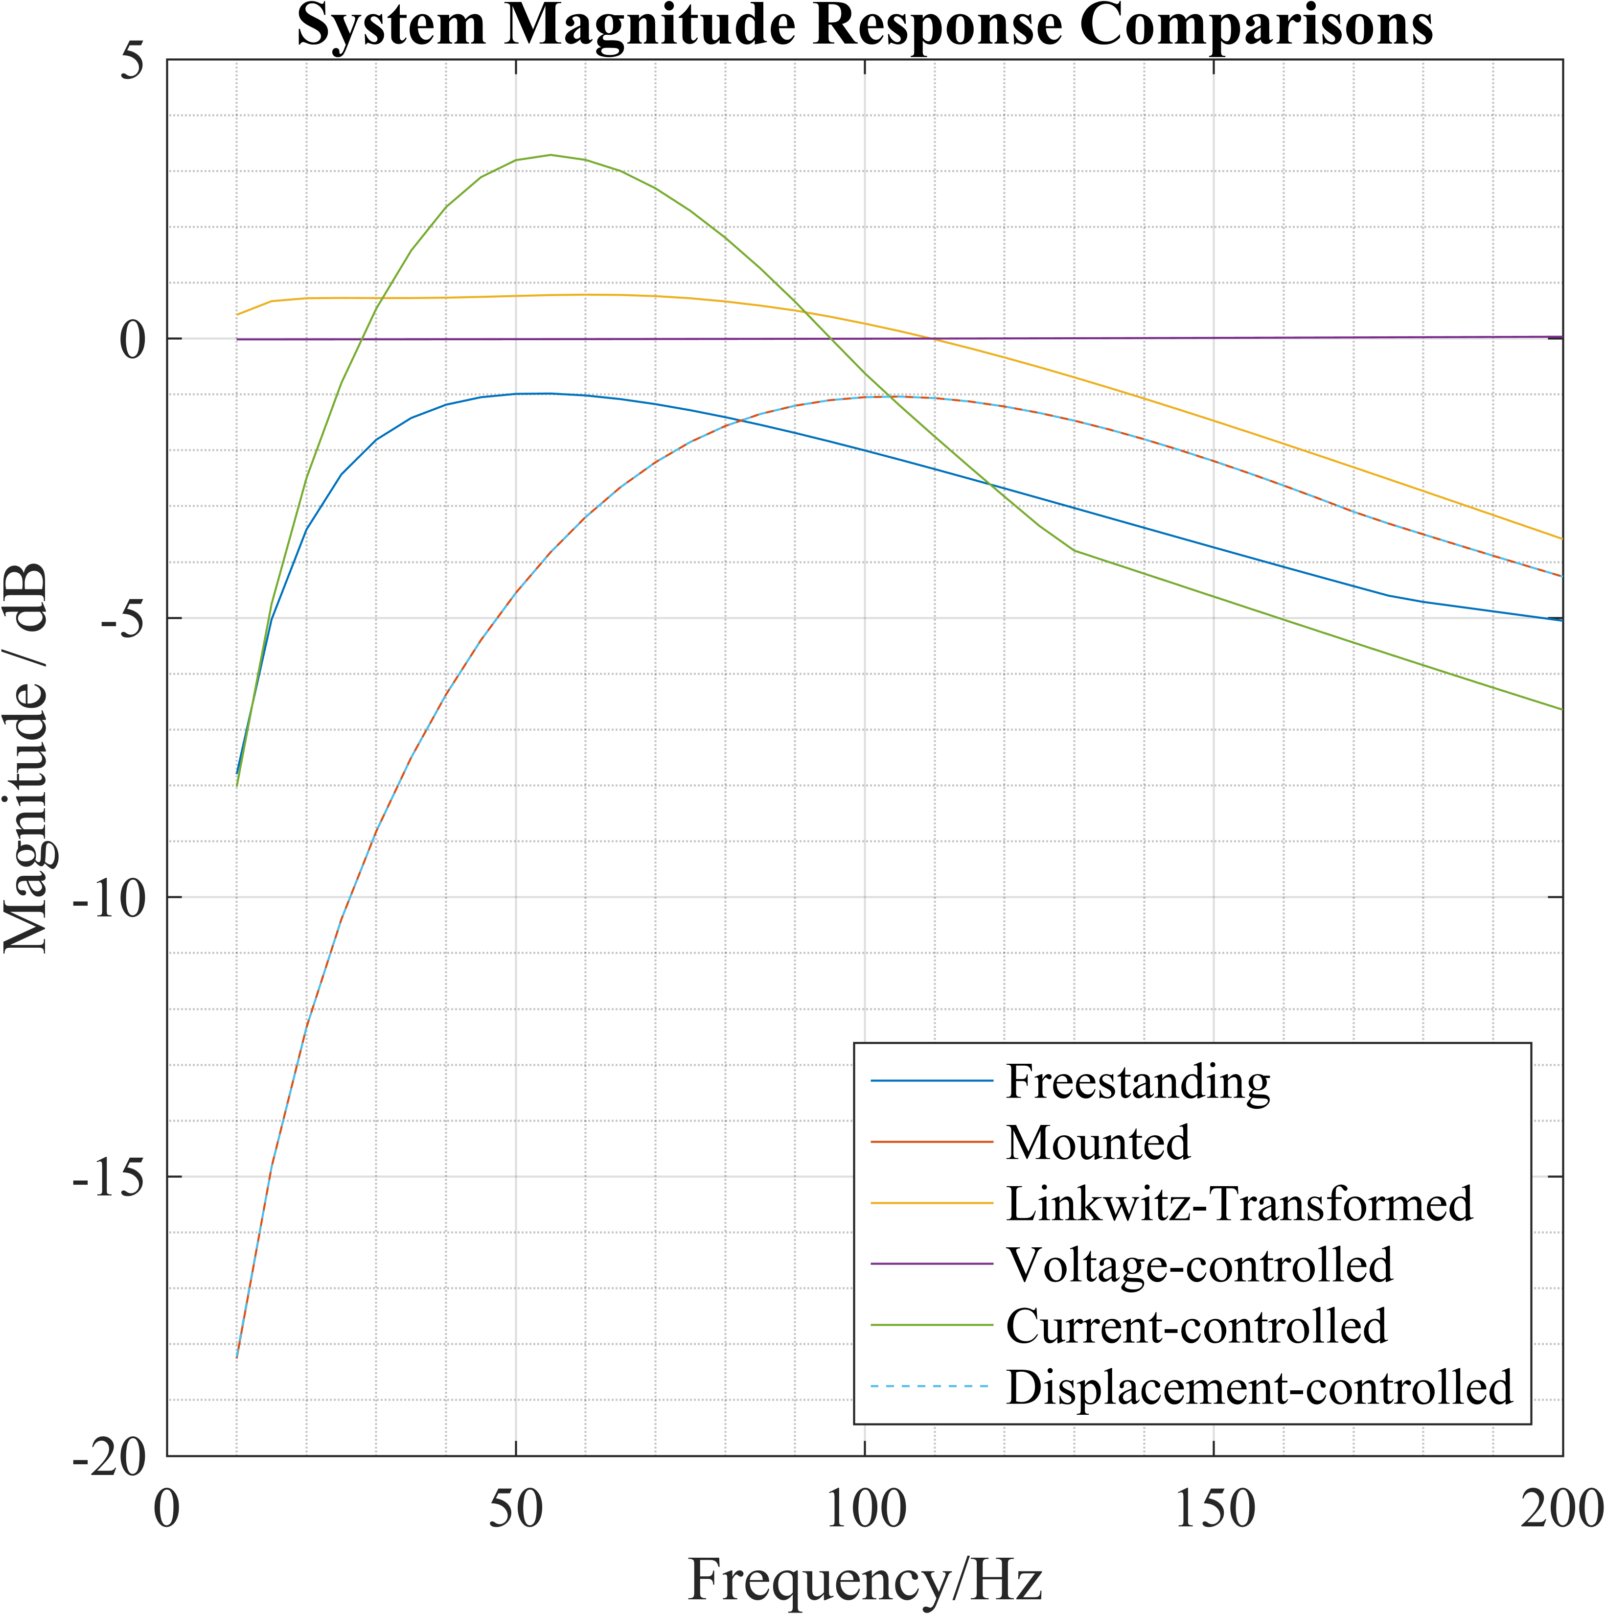
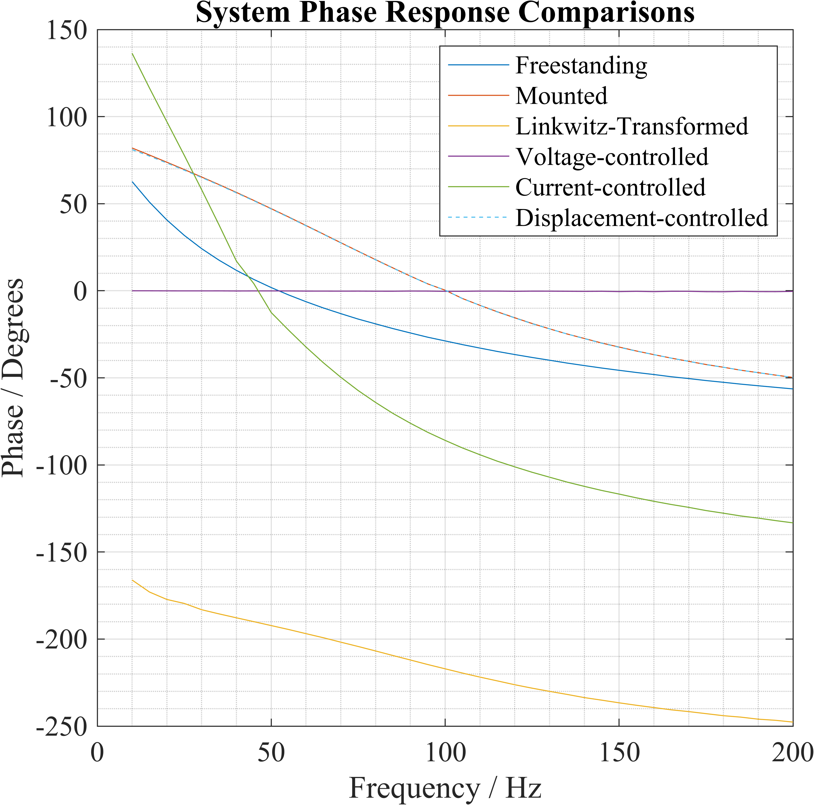
Results
Voltage controller makes the system perform perfectly
Linkwitz Transform exhibits boosted and linear performance to around 70 Hz
Current controller boosts, but does not linearize, system performance

Slide 26
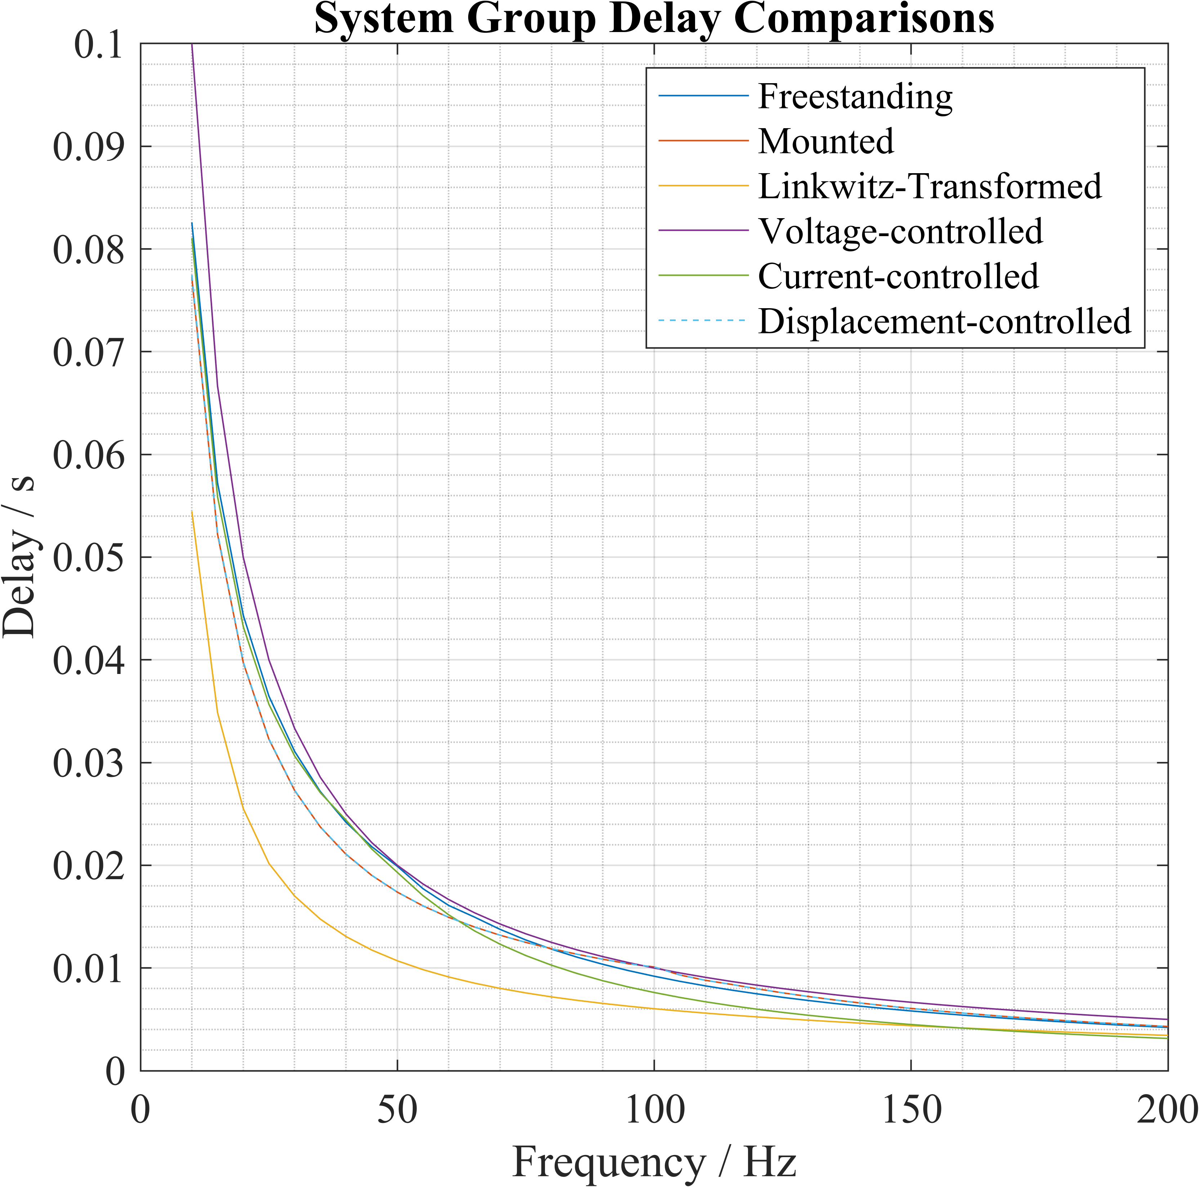
Linkwitz Transform and current controller exhibit the best and second-best group delays.
Voltage controller exhibits exceptionally poor group delay at extremely low frequencies.

Slide 27
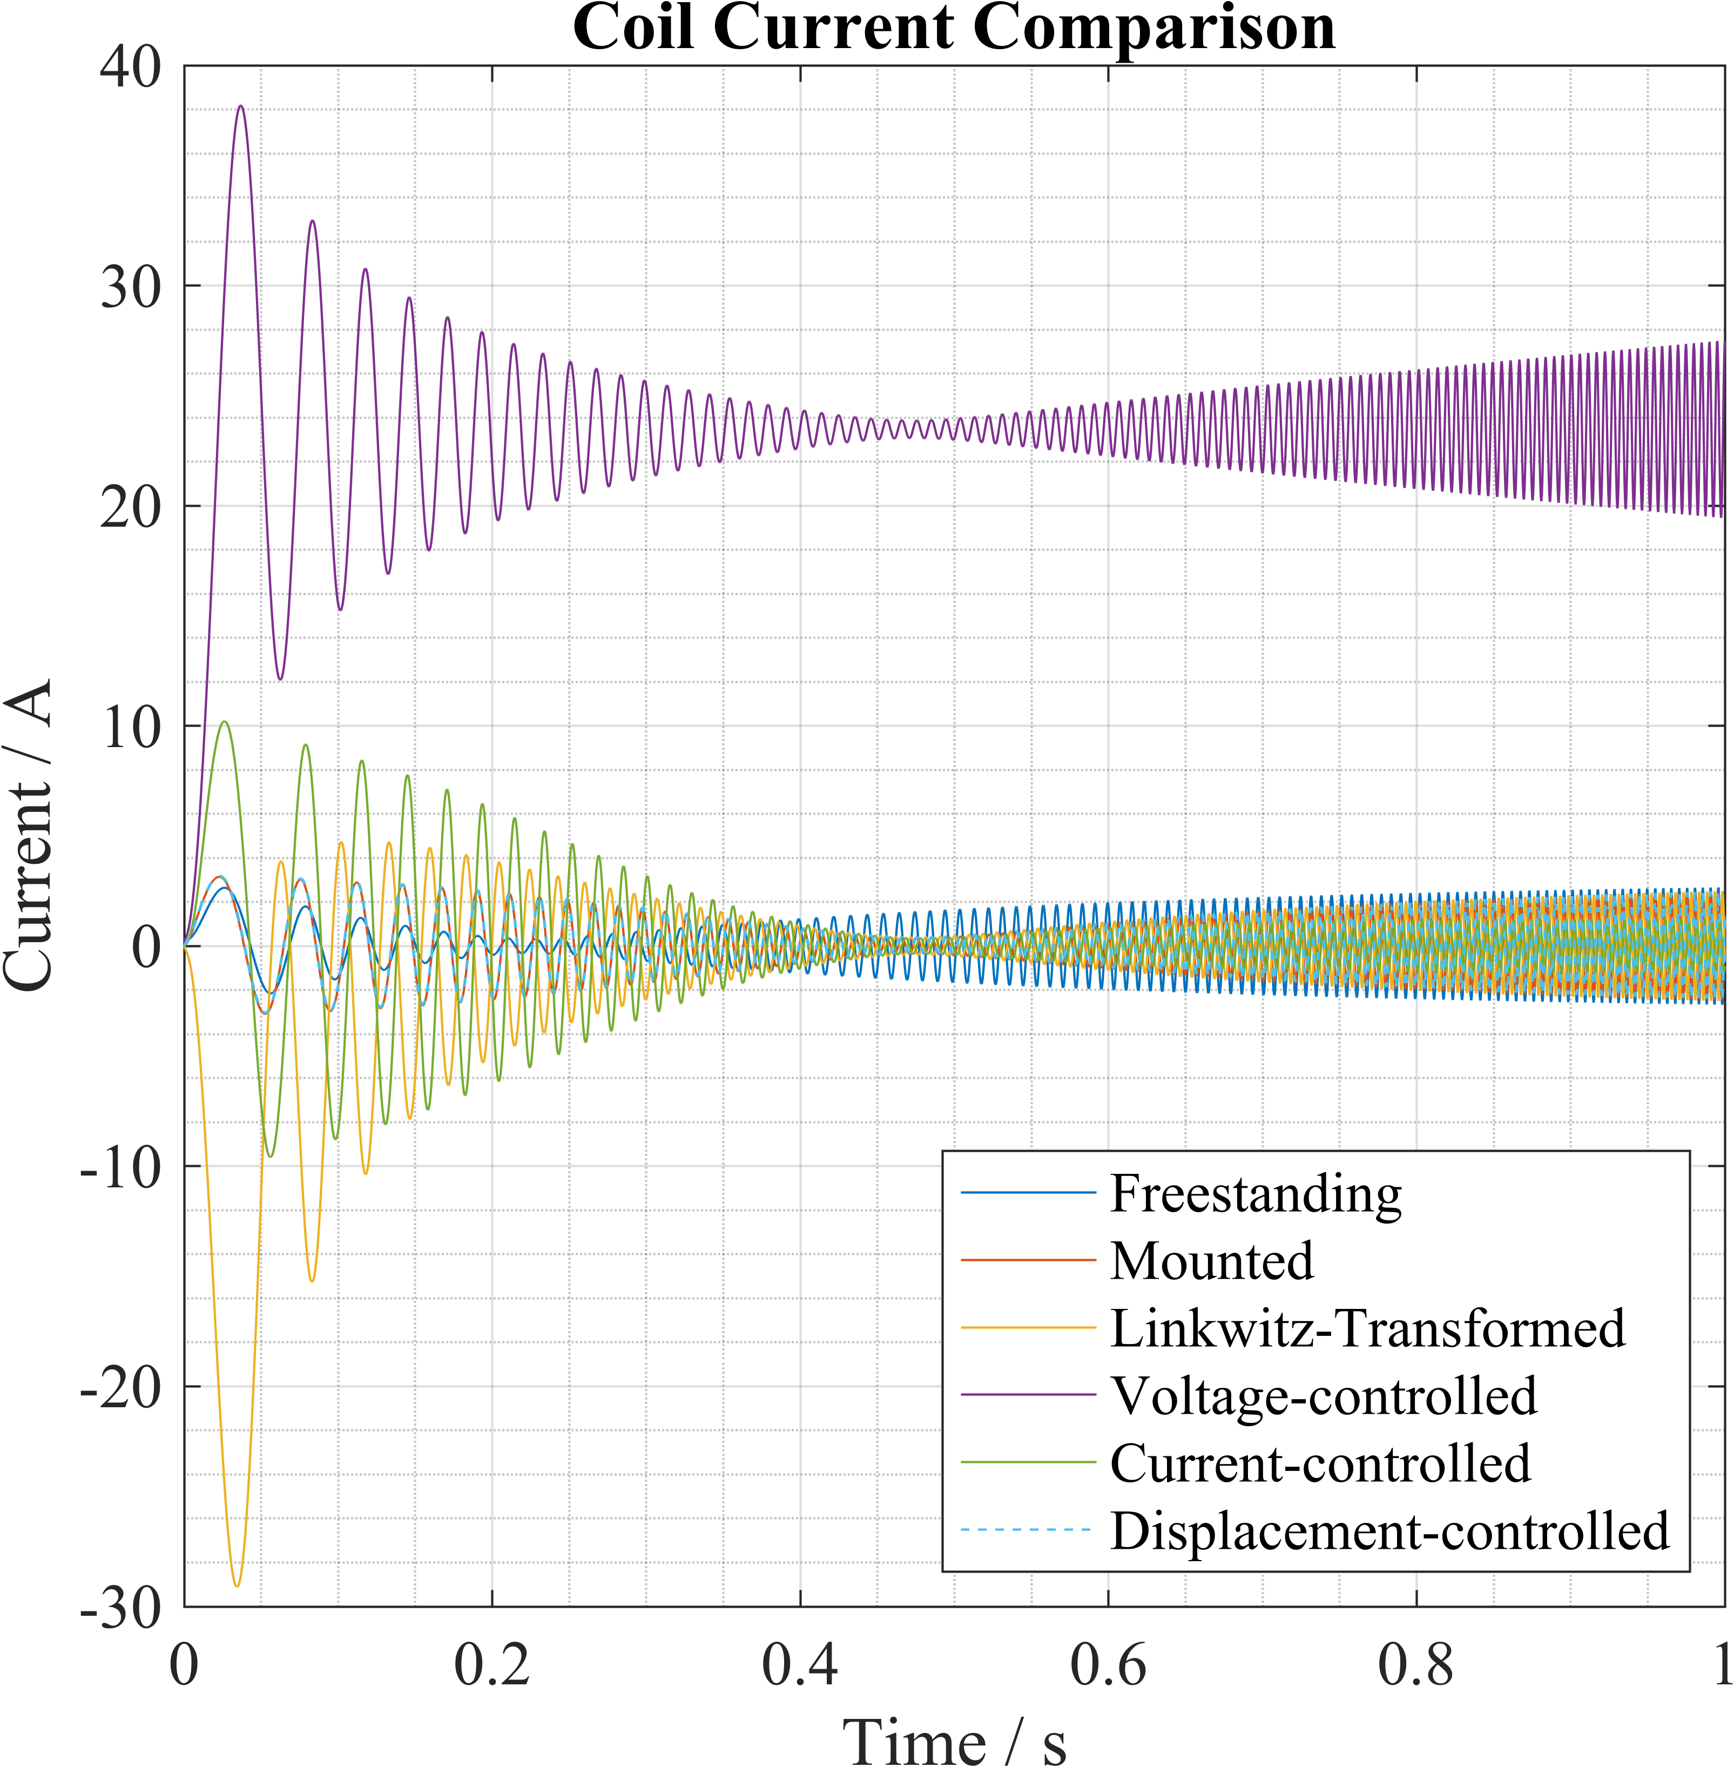
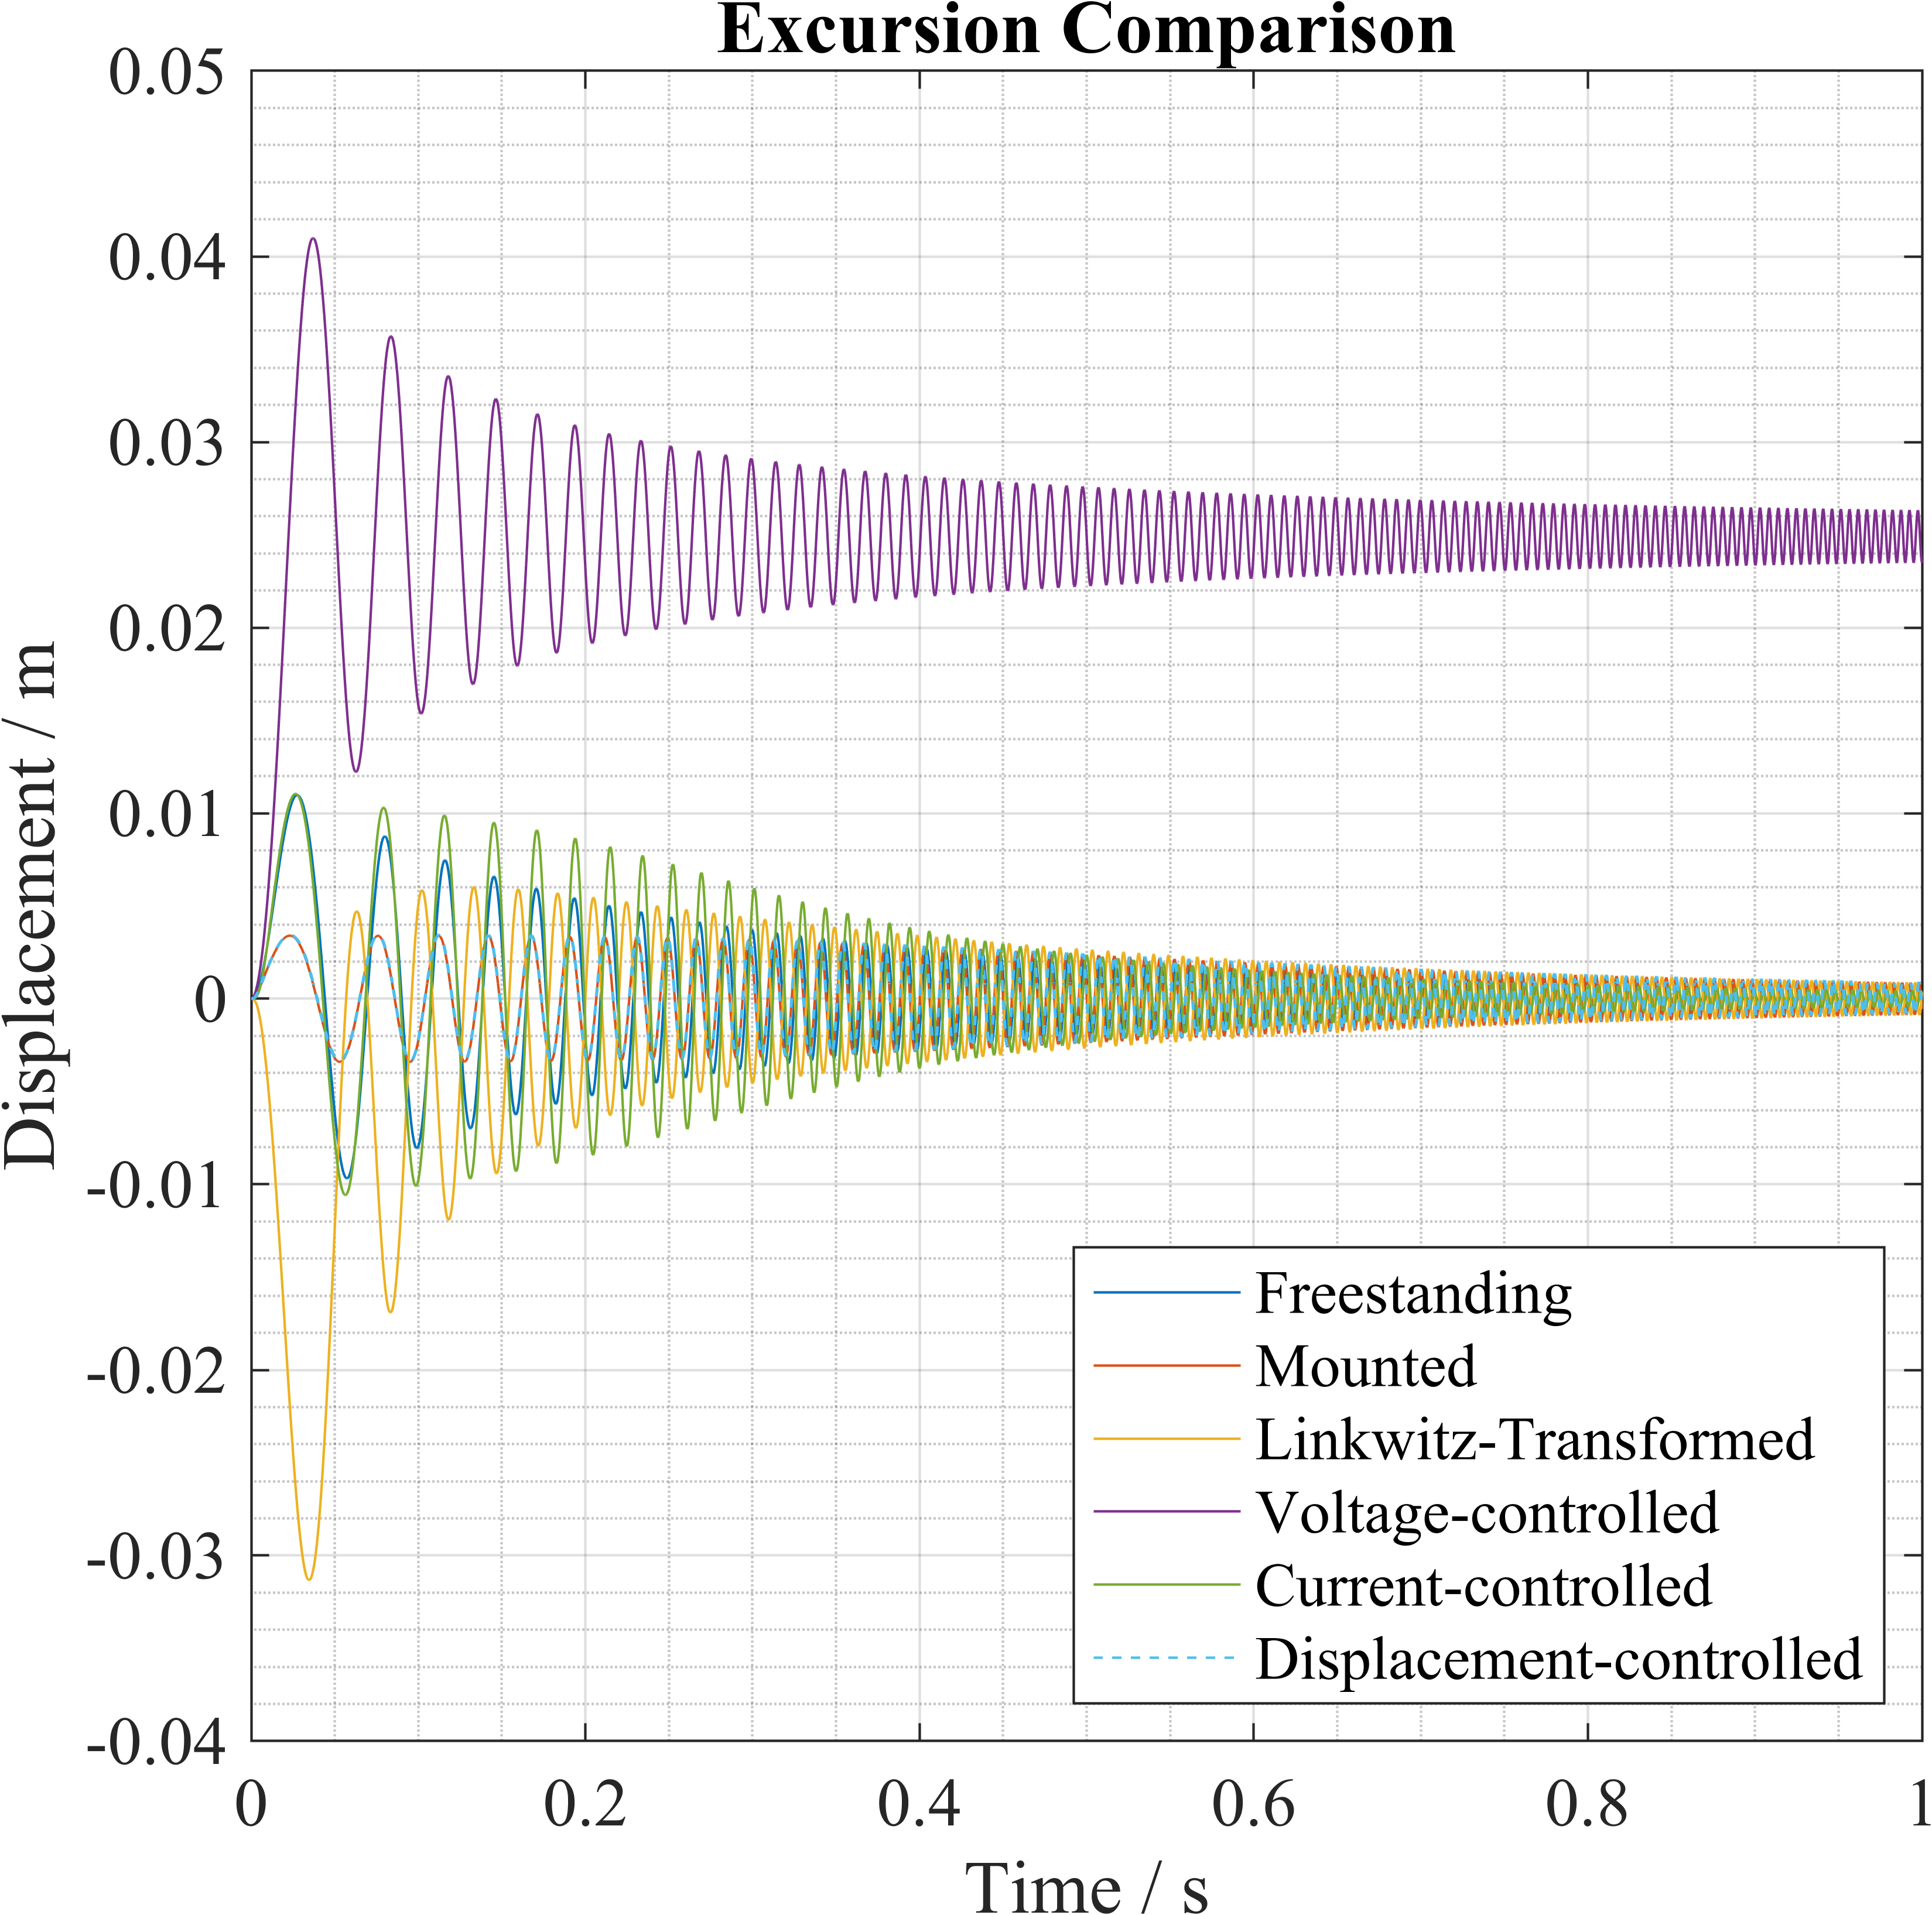
Voltage controller has unacceptable coil current and cone excursion – subwoofer would blow up!
LT and current controller have large coil current and cone excursion at low frequencies but rapidly return to acceptable levels – recorded sound rarely has <= 20 Hz sound so this is okay

Slide 28
Conclusion
Use LT to get accurate bass, use current controller to get more bass
Results are simulations – do not properly reflect real-life so should be used as guidelines for further work.
Result can only confidently be applied to other, smaller subwoofers – concert/cinema-sized subs need further investigation with the same compensators
Price of current system plus electronics that went unused ~£75 – much cheaper than overdesigned open-loop speaker systems
Overall, project was partly successful – a controller was identified but not synthesized.
COVID-19 heavily impacted the project by preventing any practical project work from occurring. Controllers could not be built and had to be tuned against datasheet TSPs.

Slide 29
Future Work

